Slide 1



Creating your own FieldPapers
http://fieldpapers.org

Slide 2
WHAT IS A FIELD PAPER ?

Slide 3
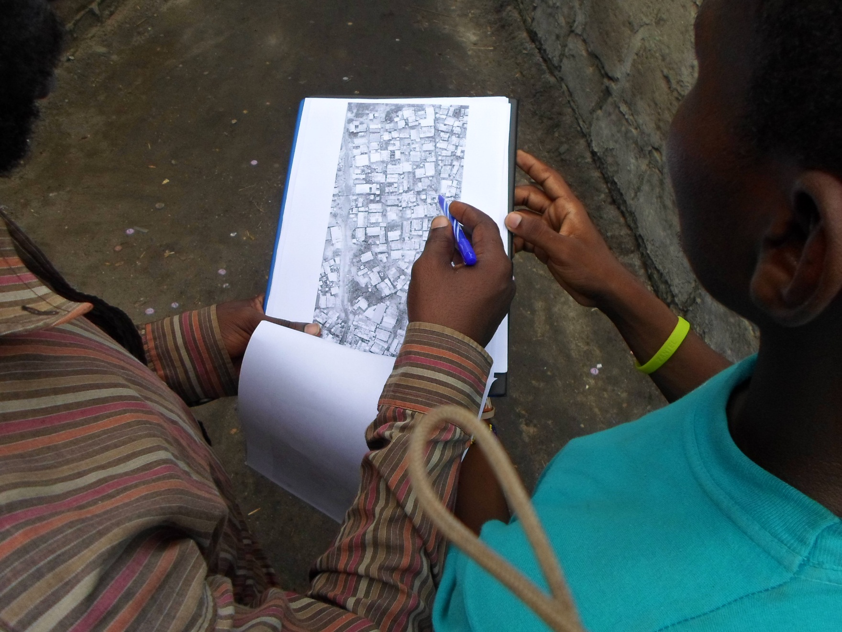
FieldPapers is web-based tool for easily creating a printable map atlas for anywhere in the world that you can print and add notes to.

Slide 4
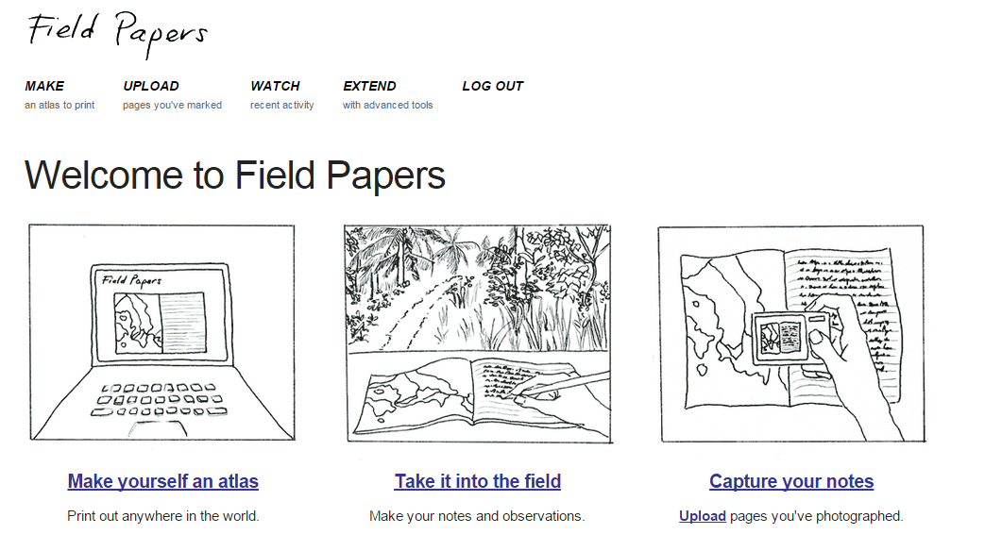
STEPS FOR CREATING ONE (www.fieldpapers.org)
Create an account (optional)

Slide 5
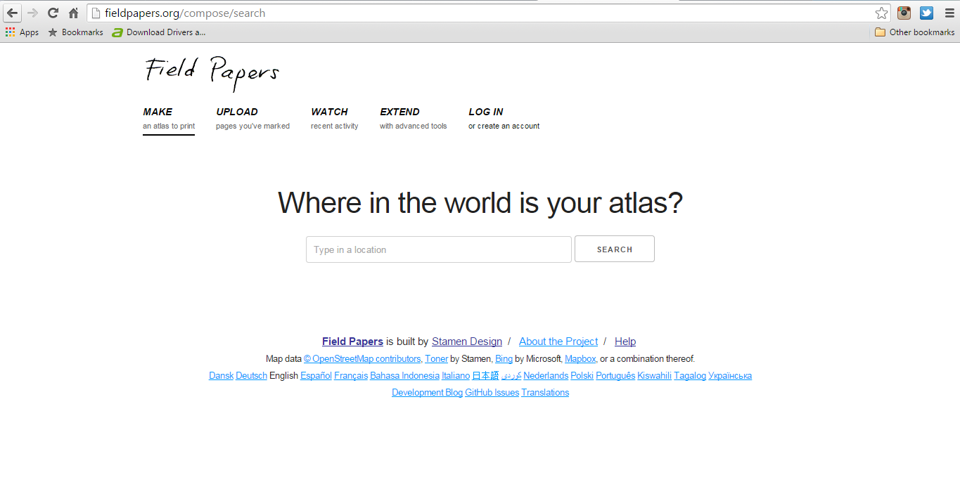
SEARCH FOR AN AREA
NB: You will need to be specific with searching the name of the area. “Dar es Salaam” works fine.

Slide 6
USE OUR CUSTOM TMS
In the third box (that says “OpenStreetMap” by default, enter:
https://a.tiles.mapbox.com/v4/droneadv.l8kc6bho/{Z}/{X}/{Y}.png?access_token=pk.eyJ1IjoiZHJvbmVhZHYiLCJhIjoiYmU0ZXQtcyJ9.8Fh95YZQ_WdYEDlgtmH95A
Click the result
Zoom in!

Slide 7
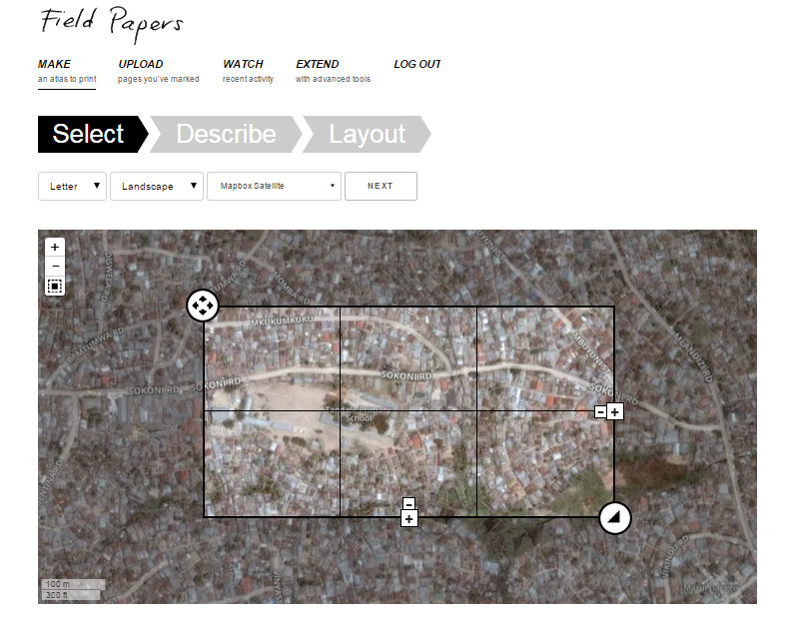
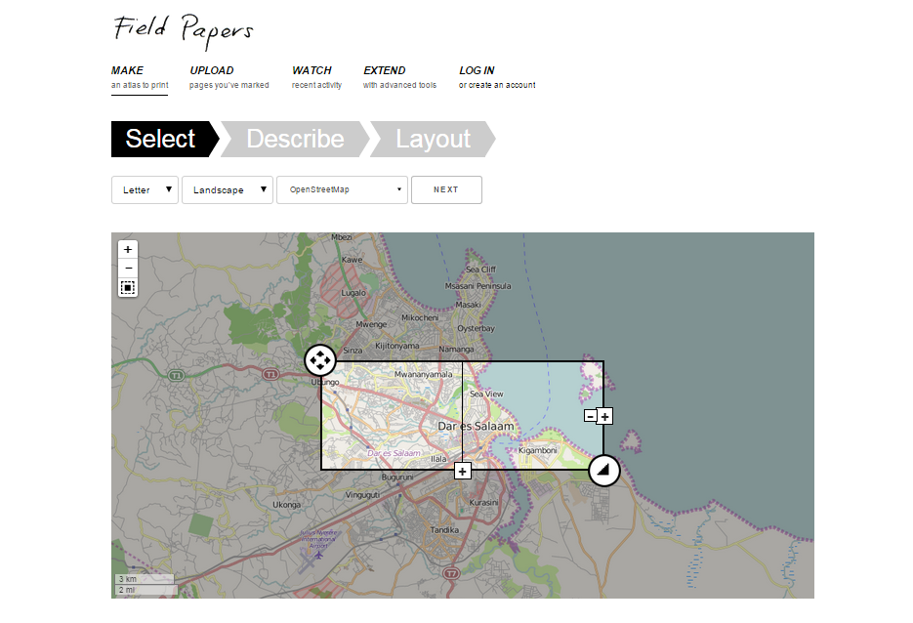
CUSTOMIZE YOUR FIELD PAPER (STEP 1)
Paper size, Orientation, Kind of Map, Zoom Level, Number of portions

Slide 8
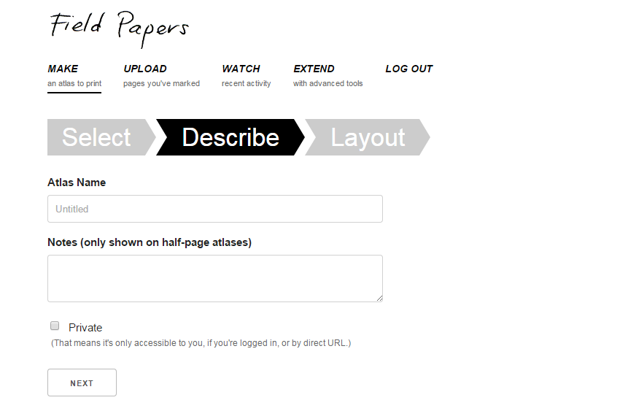
CUSTOMIZE YOUR FILED PAPER (STEP 2)
Give a name, could be name of the area and a short description of it, could features your interested in.

Slide 9
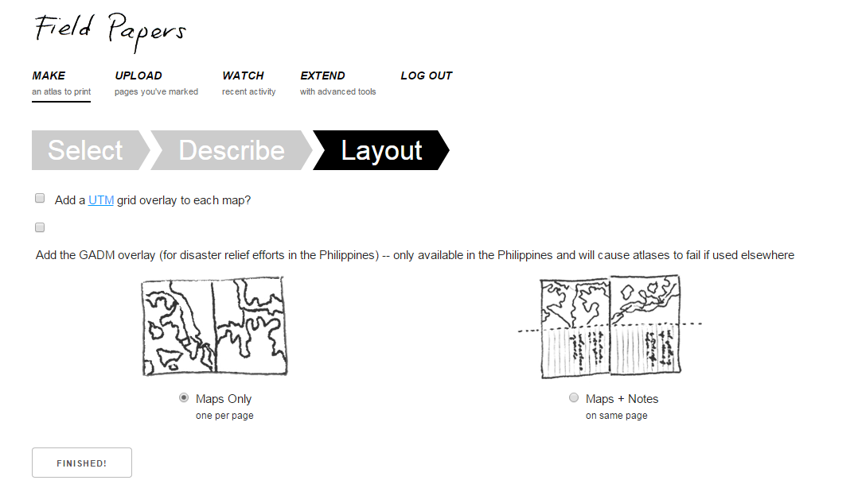
CUSTOMIZE YOUR FIELD PAPER (STEP 3)
Pick an orientation that will work best for you

Slide 10
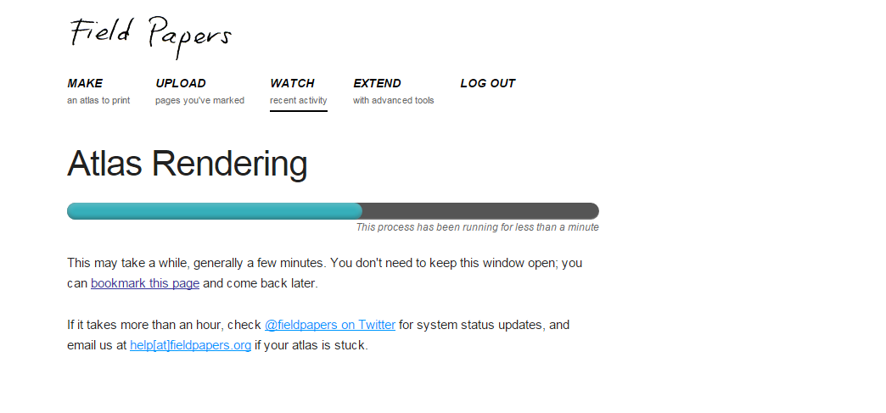
FINISHED!
At this stage your field paper is being Created.

Slide 11
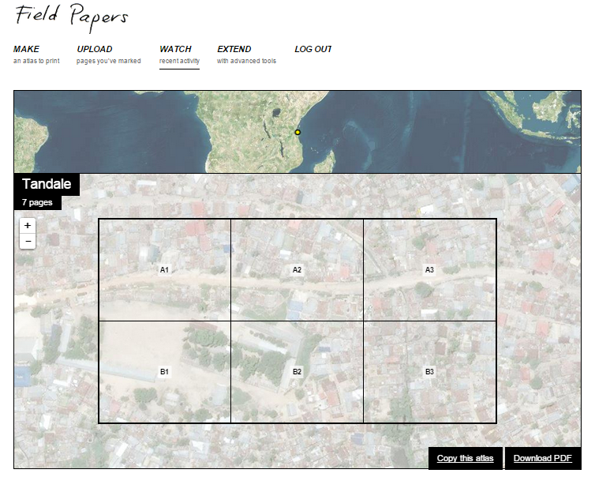
DOWNLOAD
Click the download button on the far bottom right corner to have it saved on your local drive.

Slide 12
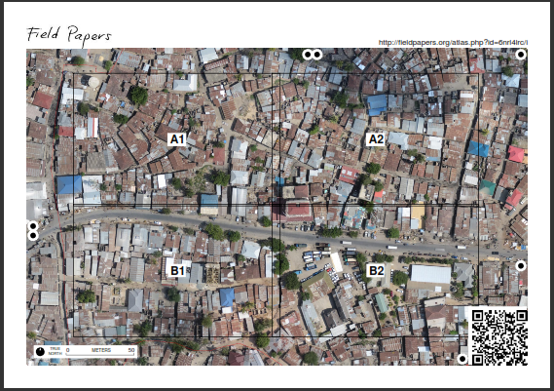
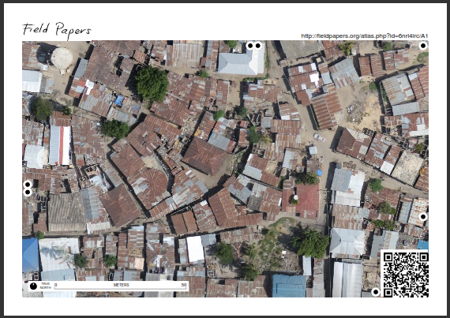
THE PAPERS ARE AUTOMATICALLY PARTITIONED FOR YOU
Its time to collect Data…

Slide 13
HOW IT WORKS….
Print the map
Go out in the field and sketch what you see
Then come back, and either take a photo/make a scan of your map and upload it or just look at your sheet of paper and use it as aid to your brain's memory
Add your surveyed information to the OpenStreetMap database (Will use JOSM in this case)

Slide 14
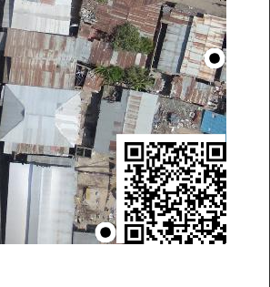
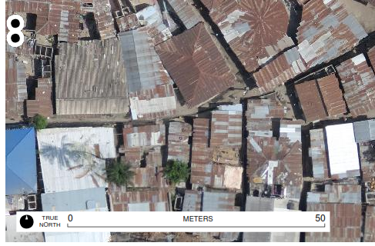
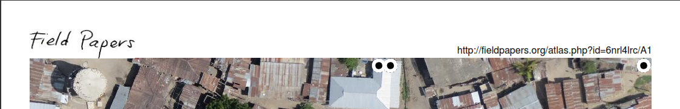
TOOLS TO NOTE!
QR CODE
SCALE
URL

Slide 15
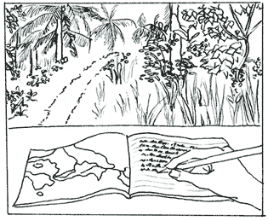
www.fieldpapers.org

